Slide 1
ASSESSMENT OF INSTITUTION-LEVEL STUDENT LEARNING GOALS • UTICA COLLEGE •
How to enter the General Education data.
Notes:
Donut with text inside
(Intermediate)
To reproduce the circle effects on this slide, do the following:
On the Home tab, in the Slides group, click Layout, and then click Blank.
On the Home tab, in the Drawing group, click Shapes, and then under Basic Shapes click Donut (third row, second option from the left). On the slide, drag to draw a donut.
Drag the yellow diamond adjustment handle to the left to decrease the width of the donut.
Select the donut. Under Drawing Tools, on the Format tab, in the Size group, do the following:
In the Shape Height box, enter 5.92”.
In the Shape Width box, enter 5.92”.
Under Drawing Tools, on the Format tab, in the Shape Styles group, click the arrow next to Shape Outline, and then click No Outline.
Also under Drawing Tools, on the Format tab, in the Shape Styles group, click the arrow next to Shape Fill, and then under Theme Colors click Olive Green, Accent 3, Darker 25% (fifth row, seventh option from the left).
Also under Drawing Tools, on the Format tab, in the Shape Styles group, click Shape Effects, and then do the following:
Point to Bevel, and then under Bevel click Soft Round (second row, second option from the left).
Point to Shadow, and then under Outer click Offset Diagonal Bottom Right (first row, first option from the left).
To reproduce the text on this slide, do the following:
On the Insert tab, in the Text group, click Text Box, and then on the slide, drag to draw the text box.
Enter text in the text box, select the text, and then on the Home tab, in the Font group, select Consolas from the Font list, enter 27 in the Font Size box, click the button next to Font Color, and then under Theme Colors click White, Background 1 (first row, first option from the left). Tip: To enter the two bullets with the text, on the Insert tab, in the Text group, click Symbol. In the Symbol dialog box, do the following:
In the Font list, select (normal text).
In the Character Code box, enter 0095 to select BULLET, and then click Insert.
On the Home tab, in the Paragraph group, click Align Text Left to align the text left in the text box.
Select the text box. Under Drawing Tools, on the Format tab, in the WordArt Styles group, click Text Effects, and then do the following:
Point to Shadow, and then under Outer click Offset Diagonal Bottom Right (first row, first option from the left).
Point to Transform, and then under Follow Path click Circle (third option from the left).
Under Drawing Tools, on the Format tab, in the Size group, do the following:
In the Shape Height box, enter 4.78”.
In the Shape Width box, enter 4.78”.
Drag the text box onto the donut shape so that the text wraps around the donut.
If the text does not wrap completely and evenly around the donut shape, select the text box and then do the following:
If the text does not wrap completely around the donut shape, on the Home tab, in the Font group, in the Font Size box, enter larger font sizes in 1-pt increments until the text is evenly spaced within the donut shape.
If the entire line of text does not fit evenly within the donut shape, on the Home tab, in the Font group, in the Font Size box, enter smaller font sizes in 1-pt increments until the text is evenly spaced within the donut shape.
If the text does not wrap completely around or does not fit evenly within the donut shape, also try editing the Character Spacing. On the Home tab, in the Font group, click Character Spacing, and then do the following:
To expand the text, in the Character Spacing list, select Loose or Very Loose.
To contract the text, in the Character Spacing list, select Tight or Very Tight.
For more precise character spacing, click More Spacing. In the Font dialog box, on the Character Spacing tab, in the Spacing list, select Expanded or Condensed. In the By box, adjust the size by 0.1-pt increments until the text is spaced evenly.
Press and hold SHIFT and select the text box and the donut shape. On the Home tab, in the Drawing group, click Arrange, and then click Group.
Select the group. On the Home tab, in the Drawing group, click Arrange, point to Align, and then do the following:
Click Align to Slide.
Click Align Center.
Click Align Middle.
To reproduce the background on this slide, do the following:
Right-click the slide background area, and then click Format Background. In the Format Background dialog box, click Fill in the left pane, select Gradient fill in the Fill pane, and then do the following:
In the Type list, select Radial.
Click the button next to Direction, and then click From Center (third option from the left).
Under Gradient stops, click Add gradient stop or Remove gradient stop until three stops appear in the slider.
Also under Gradient stops, customize the gradient stops that you added as follows:
Select the first stop in the slider, and then do the following:
In the Position box, enter 0%.
Click the button next to Color, and then under Theme Colors click Aqua, Accent 5, Darker 25% (fifth row, ninth option from the left).
Select the next stop in the slider, and then do the following:
In the Position box, enter 54%.
Click the button next to Color, and then under Theme Colors click Aqua, Accent 5, Darker 50% (sixth row, ninth option from the left).
Select the last stop in the slider, and then do the following:
In the Position box, enter 100%.
Click the button next to Color, and then under Theme Colors click Black, Text 1 (first row, second option from the left).

Slide 2
Click the Faculty tab at the top right of the UC home page.
Notes:
Donut with text inside
(Intermediate)
To reproduce the circle effects on this slide, do the following:
On the Home tab, in the Slides group, click Layout, and then click Blank.
On the Home tab, in the Drawing group, click Shapes, and then under Basic Shapes click Donut (third row, second option from the left). On the slide, drag to draw a donut.
Drag the yellow diamond adjustment handle to the left to decrease the width of the donut.
Select the donut. Under Drawing Tools, on the Format tab, in the Size group, do the following:
In the Shape Height box, enter 5.92”.
In the Shape Width box, enter 5.92”.
Under Drawing Tools, on the Format tab, in the Shape Styles group, click the arrow next to Shape Outline, and then click No Outline.
Also under Drawing Tools, on the Format tab, in the Shape Styles group, click the arrow next to Shape Fill, and then under Theme Colors click Olive Green, Accent 3, Darker 25% (fifth row, seventh option from the left).
Also under Drawing Tools, on the Format tab, in the Shape Styles group, click Shape Effects, and then do the following:
Point to Bevel, and then under Bevel click Soft Round (second row, second option from the left).
Point to Shadow, and then under Outer click Offset Diagonal Bottom Right (first row, first option from the left).
To reproduce the text on this slide, do the following:
On the Insert tab, in the Text group, click Text Box, and then on the slide, drag to draw the text box.
Enter text in the text box, select the text, and then on the Home tab, in the Font group, select Consolas from the Font list, enter 27 in the Font Size box, click the button next to Font Color, and then under Theme Colors click White, Background 1 (first row, first option from the left). Tip: To enter the two bullets with the text, on the Insert tab, in the Text group, click Symbol. In the Symbol dialog box, do the following:
In the Font list, select (normal text).
In the Character Code box, enter 0095 to select BULLET, and then click Insert.
On the Home tab, in the Paragraph group, click Align Text Left to align the text left in the text box.
Select the text box. Under Drawing Tools, on the Format tab, in the WordArt Styles group, click Text Effects, and then do the following:
Point to Shadow, and then under Outer click Offset Diagonal Bottom Right (first row, first option from the left).
Point to Transform, and then under Follow Path click Circle (third option from the left).
Under Drawing Tools, on the Format tab, in the Size group, do the following:
In the Shape Height box, enter 4.78”.
In the Shape Width box, enter 4.78”.
Drag the text box onto the donut shape so that the text wraps around the donut.
If the text does not wrap completely and evenly around the donut shape, select the text box and then do the following:
If the text does not wrap completely around the donut shape, on the Home tab, in the Font group, in the Font Size box, enter larger font sizes in 1-pt increments until the text is evenly spaced within the donut shape.
If the entire line of text does not fit evenly within the donut shape, on the Home tab, in the Font group, in the Font Size box, enter smaller font sizes in 1-pt increments until the text is evenly spaced within the donut shape.
If the text does not wrap completely around or does not fit evenly within the donut shape, also try editing the Character Spacing. On the Home tab, in the Font group, click Character Spacing, and then do the following:
To expand the text, in the Character Spacing list, select Loose or Very Loose.
To contract the text, in the Character Spacing list, select Tight or Very Tight.
For more precise character spacing, click More Spacing. In the Font dialog box, on the Character Spacing tab, in the Spacing list, select Expanded or Condensed. In the By box, adjust the size by 0.1-pt increments until the text is spaced evenly.
Press and hold SHIFT and select the text box and the donut shape. On the Home tab, in the Drawing group, click Arrange, and then click Group.
Select the group. On the Home tab, in the Drawing group, click Arrange, point to Align, and then do the following:
Click Align to Slide.
Click Align Center.
Click Align Middle.
To reproduce the background on this slide, do the following:
Right-click the slide background area, and then click Format Background. In the Format Background dialog box, click Fill in the left pane, select Gradient fill in the Fill pane, and then do the following:
In the Type list, select Radial.
Click the button next to Direction, and then click From Center (third option from the left).
Under Gradient stops, click Add gradient stop or Remove gradient stop until three stops appear in the slider.
Also under Gradient stops, customize the gradient stops that you added as follows:
Select the first stop in the slider, and then do the following:
In the Position box, enter 0%.
Click the button next to Color, and then under Theme Colors click Aqua, Accent 5, Darker 25% (fifth row, ninth option from the left).
Select the next stop in the slider, and then do the following:
In the Position box, enter 54%.
Click the button next to Color, and then under Theme Colors click Aqua, Accent 5, Darker 50% (sixth row, ninth option from the left).
Select the last stop in the slider, and then do the following:
In the Position box, enter 100%.
Click the button next to Color, and then under Theme Colors click Black, Text 1 (first row, second option from the left).

Slide 3
Click the Logins tab on the Faculty page.
Notes:
Donut with text inside
(Intermediate)
To reproduce the circle effects on this slide, do the following:
On the Home tab, in the Slides group, click Layout, and then click Blank.
On the Home tab, in the Drawing group, click Shapes, and then under Basic Shapes click Donut (third row, second option from the left). On the slide, drag to draw a donut.
Drag the yellow diamond adjustment handle to the left to decrease the width of the donut.
Select the donut. Under Drawing Tools, on the Format tab, in the Size group, do the following:
In the Shape Height box, enter 5.92”.
In the Shape Width box, enter 5.92”.
Under Drawing Tools, on the Format tab, in the Shape Styles group, click the arrow next to Shape Outline, and then click No Outline.
Also under Drawing Tools, on the Format tab, in the Shape Styles group, click the arrow next to Shape Fill, and then under Theme Colors click Olive Green, Accent 3, Darker 25% (fifth row, seventh option from the left).
Also under Drawing Tools, on the Format tab, in the Shape Styles group, click Shape Effects, and then do the following:
Point to Bevel, and then under Bevel click Soft Round (second row, second option from the left).
Point to Shadow, and then under Outer click Offset Diagonal Bottom Right (first row, first option from the left).
To reproduce the text on this slide, do the following:
On the Insert tab, in the Text group, click Text Box, and then on the slide, drag to draw the text box.
Enter text in the text box, select the text, and then on the Home tab, in the Font group, select Consolas from the Font list, enter 27 in the Font Size box, click the button next to Font Color, and then under Theme Colors click White, Background 1 (first row, first option from the left). Tip: To enter the two bullets with the text, on the Insert tab, in the Text group, click Symbol. In the Symbol dialog box, do the following:
In the Font list, select (normal text).
In the Character Code box, enter 0095 to select BULLET, and then click Insert.
On the Home tab, in the Paragraph group, click Align Text Left to align the text left in the text box.
Select the text box. Under Drawing Tools, on the Format tab, in the WordArt Styles group, click Text Effects, and then do the following:
Point to Shadow, and then under Outer click Offset Diagonal Bottom Right (first row, first option from the left).
Point to Transform, and then under Follow Path click Circle (third option from the left).
Under Drawing Tools, on the Format tab, in the Size group, do the following:
In the Shape Height box, enter 4.78”.
In the Shape Width box, enter 4.78”.
Drag the text box onto the donut shape so that the text wraps around the donut.
If the text does not wrap completely and evenly around the donut shape, select the text box and then do the following:
If the text does not wrap completely around the donut shape, on the Home tab, in the Font group, in the Font Size box, enter larger font sizes in 1-pt increments until the text is evenly spaced within the donut shape.
If the entire line of text does not fit evenly within the donut shape, on the Home tab, in the Font group, in the Font Size box, enter smaller font sizes in 1-pt increments until the text is evenly spaced within the donut shape.
If the text does not wrap completely around or does not fit evenly within the donut shape, also try editing the Character Spacing. On the Home tab, in the Font group, click Character Spacing, and then do the following:
To expand the text, in the Character Spacing list, select Loose or Very Loose.
To contract the text, in the Character Spacing list, select Tight or Very Tight.
For more precise character spacing, click More Spacing. In the Font dialog box, on the Character Spacing tab, in the Spacing list, select Expanded or Condensed. In the By box, adjust the size by 0.1-pt increments until the text is spaced evenly.
Press and hold SHIFT and select the text box and the donut shape. On the Home tab, in the Drawing group, click Arrange, and then click Group.
Select the group. On the Home tab, in the Drawing group, click Arrange, point to Align, and then do the following:
Click Align to Slide.
Click Align Center.
Click Align Middle.
To reproduce the background on this slide, do the following:
Right-click the slide background area, and then click Format Background. In the Format Background dialog box, click Fill in the left pane, select Gradient fill in the Fill pane, and then do the following:
In the Type list, select Radial.
Click the button next to Direction, and then click From Center (third option from the left).
Under Gradient stops, click Add gradient stop or Remove gradient stop until three stops appear in the slider.
Also under Gradient stops, customize the gradient stops that you added as follows:
Select the first stop in the slider, and then do the following:
In the Position box, enter 0%.
Click the button next to Color, and then under Theme Colors click Aqua, Accent 5, Darker 25% (fifth row, ninth option from the left).
Select the next stop in the slider, and then do the following:
In the Position box, enter 54%.
Click the button next to Color, and then under Theme Colors click Aqua, Accent 5, Darker 50% (sixth row, ninth option from the left).
Select the last stop in the slider, and then do the following:
In the Position box, enter 100%.
Click the button next to Color, and then under Theme Colors click Black, Text 1 (first row, second option from the left).

Slide 4
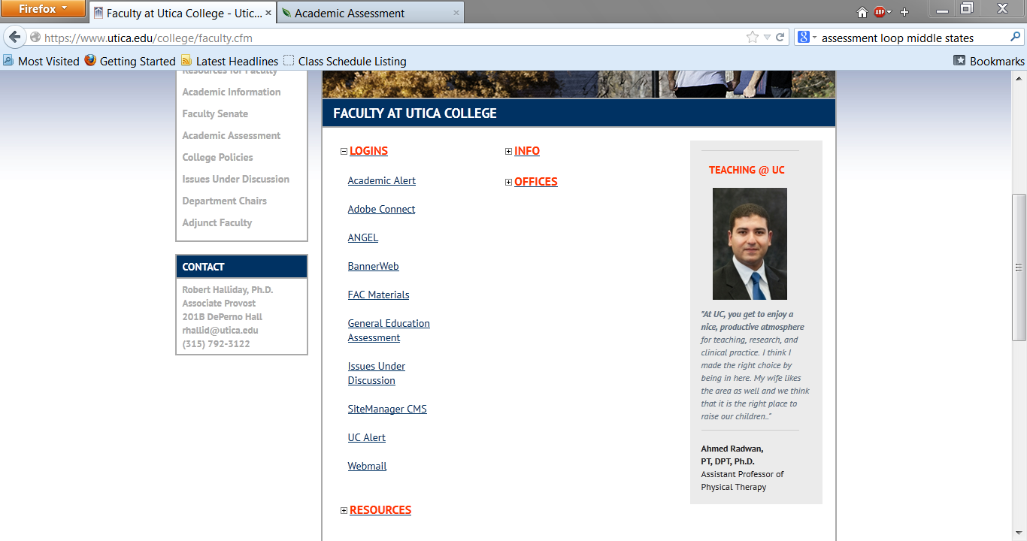
Click the General Education Assessment link.
Notes:
Donut with text inside
(Intermediate)
To reproduce the circle effects on this slide, do the following:
On the Home tab, in the Slides group, click Layout, and then click Blank.
On the Home tab, in the Drawing group, click Shapes, and then under Basic Shapes click Donut (third row, second option from the left). On the slide, drag to draw a donut.
Drag the yellow diamond adjustment handle to the left to decrease the width of the donut.
Select the donut. Under Drawing Tools, on the Format tab, in the Size group, do the following:
In the Shape Height box, enter 5.92”.
In the Shape Width box, enter 5.92”.
Under Drawing Tools, on the Format tab, in the Shape Styles group, click the arrow next to Shape Outline, and then click No Outline.
Also under Drawing Tools, on the Format tab, in the Shape Styles group, click the arrow next to Shape Fill, and then under Theme Colors click Olive Green, Accent 3, Darker 25% (fifth row, seventh option from the left).
Also under Drawing Tools, on the Format tab, in the Shape Styles group, click Shape Effects, and then do the following:
Point to Bevel, and then under Bevel click Soft Round (second row, second option from the left).
Point to Shadow, and then under Outer click Offset Diagonal Bottom Right (first row, first option from the left).
To reproduce the text on this slide, do the following:
On the Insert tab, in the Text group, click Text Box, and then on the slide, drag to draw the text box.
Enter text in the text box, select the text, and then on the Home tab, in the Font group, select Consolas from the Font list, enter 27 in the Font Size box, click the button next to Font Color, and then under Theme Colors click White, Background 1 (first row, first option from the left). Tip: To enter the two bullets with the text, on the Insert tab, in the Text group, click Symbol. In the Symbol dialog box, do the following:
In the Font list, select (normal text).
In the Character Code box, enter 0095 to select BULLET, and then click Insert.
On the Home tab, in the Paragraph group, click Align Text Left to align the text left in the text box.
Select the text box. Under Drawing Tools, on the Format tab, in the WordArt Styles group, click Text Effects, and then do the following:
Point to Shadow, and then under Outer click Offset Diagonal Bottom Right (first row, first option from the left).
Point to Transform, and then under Follow Path click Circle (third option from the left).
Under Drawing Tools, on the Format tab, in the Size group, do the following:
In the Shape Height box, enter 4.78”.
In the Shape Width box, enter 4.78”.
Drag the text box onto the donut shape so that the text wraps around the donut.
If the text does not wrap completely and evenly around the donut shape, select the text box and then do the following:
If the text does not wrap completely around the donut shape, on the Home tab, in the Font group, in the Font Size box, enter larger font sizes in 1-pt increments until the text is evenly spaced within the donut shape.
If the entire line of text does not fit evenly within the donut shape, on the Home tab, in the Font group, in the Font Size box, enter smaller font sizes in 1-pt increments until the text is evenly spaced within the donut shape.
If the text does not wrap completely around or does not fit evenly within the donut shape, also try editing the Character Spacing. On the Home tab, in the Font group, click Character Spacing, and then do the following:
To expand the text, in the Character Spacing list, select Loose or Very Loose.
To contract the text, in the Character Spacing list, select Tight or Very Tight.
For more precise character spacing, click More Spacing. In the Font dialog box, on the Character Spacing tab, in the Spacing list, select Expanded or Condensed. In the By box, adjust the size by 0.1-pt increments until the text is spaced evenly.
Press and hold SHIFT and select the text box and the donut shape. On the Home tab, in the Drawing group, click Arrange, and then click Group.
Select the group. On the Home tab, in the Drawing group, click Arrange, point to Align, and then do the following:
Click Align to Slide.
Click Align Center.
Click Align Middle.
To reproduce the background on this slide, do the following:
Right-click the slide background area, and then click Format Background. In the Format Background dialog box, click Fill in the left pane, select Gradient fill in the Fill pane, and then do the following:
In the Type list, select Radial.
Click the button next to Direction, and then click From Center (third option from the left).
Under Gradient stops, click Add gradient stop or Remove gradient stop until three stops appear in the slider.
Also under Gradient stops, customize the gradient stops that you added as follows:
Select the first stop in the slider, and then do the following:
In the Position box, enter 0%.
Click the button next to Color, and then under Theme Colors click Aqua, Accent 5, Darker 25% (fifth row, ninth option from the left).
Select the next stop in the slider, and then do the following:
In the Position box, enter 54%.
Click the button next to Color, and then under Theme Colors click Aqua, Accent 5, Darker 50% (sixth row, ninth option from the left).
Select the last stop in the slider, and then do the following:
In the Position box, enter 100%.
Click the button next to Color, and then under Theme Colors click Black, Text 1 (first row, second option from the left).

Slide 5
Enter your faculty login information.
It will be the same as your UC email login.
Notes:
Donut with text inside
(Intermediate)
To reproduce the circle effects on this slide, do the following:
On the Home tab, in the Slides group, click Layout, and then click Blank.
On the Home tab, in the Drawing group, click Shapes, and then under Basic Shapes click Donut (third row, second option from the left). On the slide, drag to draw a donut.
Drag the yellow diamond adjustment handle to the left to decrease the width of the donut.
Select the donut. Under Drawing Tools, on the Format tab, in the Size group, do the following:
In the Shape Height box, enter 5.92”.
In the Shape Width box, enter 5.92”.
Under Drawing Tools, on the Format tab, in the Shape Styles group, click the arrow next to Shape Outline, and then click No Outline.
Also under Drawing Tools, on the Format tab, in the Shape Styles group, click the arrow next to Shape Fill, and then under Theme Colors click Olive Green, Accent 3, Darker 25% (fifth row, seventh option from the left).
Also under Drawing Tools, on the Format tab, in the Shape Styles group, click Shape Effects, and then do the following:
Point to Bevel, and then under Bevel click Soft Round (second row, second option from the left).
Point to Shadow, and then under Outer click Offset Diagonal Bottom Right (first row, first option from the left).
To reproduce the text on this slide, do the following:
On the Insert tab, in the Text group, click Text Box, and then on the slide, drag to draw the text box.
Enter text in the text box, select the text, and then on the Home tab, in the Font group, select Consolas from the Font list, enter 27 in the Font Size box, click the button next to Font Color, and then under Theme Colors click White, Background 1 (first row, first option from the left). Tip: To enter the two bullets with the text, on the Insert tab, in the Text group, click Symbol. In the Symbol dialog box, do the following:
In the Font list, select (normal text).
In the Character Code box, enter 0095 to select BULLET, and then click Insert.
On the Home tab, in the Paragraph group, click Align Text Left to align the text left in the text box.
Select the text box. Under Drawing Tools, on the Format tab, in the WordArt Styles group, click Text Effects, and then do the following:
Point to Shadow, and then under Outer click Offset Diagonal Bottom Right (first row, first option from the left).
Point to Transform, and then under Follow Path click Circle (third option from the left).
Under Drawing Tools, on the Format tab, in the Size group, do the following:
In the Shape Height box, enter 4.78”.
In the Shape Width box, enter 4.78”.
Drag the text box onto the donut shape so that the text wraps around the donut.
If the text does not wrap completely and evenly around the donut shape, select the text box and then do the following:
If the text does not wrap completely around the donut shape, on the Home tab, in the Font group, in the Font Size box, enter larger font sizes in 1-pt increments until the text is evenly spaced within the donut shape.
If the entire line of text does not fit evenly within the donut shape, on the Home tab, in the Font group, in the Font Size box, enter smaller font sizes in 1-pt increments until the text is evenly spaced within the donut shape.
If the text does not wrap completely around or does not fit evenly within the donut shape, also try editing the Character Spacing. On the Home tab, in the Font group, click Character Spacing, and then do the following:
To expand the text, in the Character Spacing list, select Loose or Very Loose.
To contract the text, in the Character Spacing list, select Tight or Very Tight.
For more precise character spacing, click More Spacing. In the Font dialog box, on the Character Spacing tab, in the Spacing list, select Expanded or Condensed. In the By box, adjust the size by 0.1-pt increments until the text is spaced evenly.
Press and hold SHIFT and select the text box and the donut shape. On the Home tab, in the Drawing group, click Arrange, and then click Group.
Select the group. On the Home tab, in the Drawing group, click Arrange, point to Align, and then do the following:
Click Align to Slide.
Click Align Center.
Click Align Middle.
To reproduce the background on this slide, do the following:
Right-click the slide background area, and then click Format Background. In the Format Background dialog box, click Fill in the left pane, select Gradient fill in the Fill pane, and then do the following:
In the Type list, select Radial.
Click the button next to Direction, and then click From Center (third option from the left).
Under Gradient stops, click Add gradient stop or Remove gradient stop until three stops appear in the slider.
Also under Gradient stops, customize the gradient stops that you added as follows:
Select the first stop in the slider, and then do the following:
In the Position box, enter 0%.
Click the button next to Color, and then under Theme Colors click Aqua, Accent 5, Darker 25% (fifth row, ninth option from the left).
Select the next stop in the slider, and then do the following:
In the Position box, enter 54%.
Click the button next to Color, and then under Theme Colors click Aqua, Accent 5, Darker 50% (sixth row, ninth option from the left).
Select the last stop in the slider, and then do the following:
In the Position box, enter 100%.
Click the button next to Color, and then under Theme Colors click Black, Text 1 (first row, second option from the left).

Slide 6
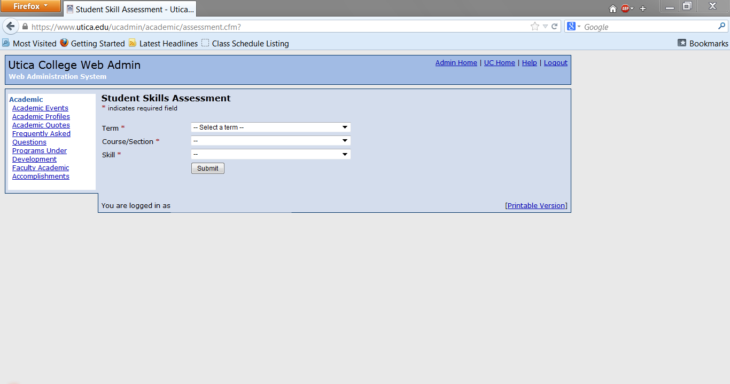
Use the drop-down choices to select the correct term, course, and (General Education) Skill.
Notes:
Donut with text inside
(Intermediate)
To reproduce the circle effects on this slide, do the following:
On the Home tab, in the Slides group, click Layout, and then click Blank.
On the Home tab, in the Drawing group, click Shapes, and then under Basic Shapes click Donut (third row, second option from the left). On the slide, drag to draw a donut.
Drag the yellow diamond adjustment handle to the left to decrease the width of the donut.
Select the donut. Under Drawing Tools, on the Format tab, in the Size group, do the following:
In the Shape Height box, enter 5.92”.
In the Shape Width box, enter 5.92”.
Under Drawing Tools, on the Format tab, in the Shape Styles group, click the arrow next to Shape Outline, and then click No Outline.
Also under Drawing Tools, on the Format tab, in the Shape Styles group, click the arrow next to Shape Fill, and then under Theme Colors click Olive Green, Accent 3, Darker 25% (fifth row, seventh option from the left).
Also under Drawing Tools, on the Format tab, in the Shape Styles group, click Shape Effects, and then do the following:
Point to Bevel, and then under Bevel click Soft Round (second row, second option from the left).
Point to Shadow, and then under Outer click Offset Diagonal Bottom Right (first row, first option from the left).
To reproduce the text on this slide, do the following:
On the Insert tab, in the Text group, click Text Box, and then on the slide, drag to draw the text box.
Enter text in the text box, select the text, and then on the Home tab, in the Font group, select Consolas from the Font list, enter 27 in the Font Size box, click the button next to Font Color, and then under Theme Colors click White, Background 1 (first row, first option from the left). Tip: To enter the two bullets with the text, on the Insert tab, in the Text group, click Symbol. In the Symbol dialog box, do the following:
In the Font list, select (normal text).
In the Character Code box, enter 0095 to select BULLET, and then click Insert.
On the Home tab, in the Paragraph group, click Align Text Left to align the text left in the text box.
Select the text box. Under Drawing Tools, on the Format tab, in the WordArt Styles group, click Text Effects, and then do the following:
Point to Shadow, and then under Outer click Offset Diagonal Bottom Right (first row, first option from the left).
Point to Transform, and then under Follow Path click Circle (third option from the left).
Under Drawing Tools, on the Format tab, in the Size group, do the following:
In the Shape Height box, enter 4.78”.
In the Shape Width box, enter 4.78”.
Drag the text box onto the donut shape so that the text wraps around the donut.
If the text does not wrap completely and evenly around the donut shape, select the text box and then do the following:
If the text does not wrap completely around the donut shape, on the Home tab, in the Font group, in the Font Size box, enter larger font sizes in 1-pt increments until the text is evenly spaced within the donut shape.
If the entire line of text does not fit evenly within the donut shape, on the Home tab, in the Font group, in the Font Size box, enter smaller font sizes in 1-pt increments until the text is evenly spaced within the donut shape.
If the text does not wrap completely around or does not fit evenly within the donut shape, also try editing the Character Spacing. On the Home tab, in the Font group, click Character Spacing, and then do the following:
To expand the text, in the Character Spacing list, select Loose or Very Loose.
To contract the text, in the Character Spacing list, select Tight or Very Tight.
For more precise character spacing, click More Spacing. In the Font dialog box, on the Character Spacing tab, in the Spacing list, select Expanded or Condensed. In the By box, adjust the size by 0.1-pt increments until the text is spaced evenly.
Press and hold SHIFT and select the text box and the donut shape. On the Home tab, in the Drawing group, click Arrange, and then click Group.
Select the group. On the Home tab, in the Drawing group, click Arrange, point to Align, and then do the following:
Click Align to Slide.
Click Align Center.
Click Align Middle.
To reproduce the background on this slide, do the following:
Right-click the slide background area, and then click Format Background. In the Format Background dialog box, click Fill in the left pane, select Gradient fill in the Fill pane, and then do the following:
In the Type list, select Radial.
Click the button next to Direction, and then click From Center (third option from the left).
Under Gradient stops, click Add gradient stop or Remove gradient stop until three stops appear in the slider.
Also under Gradient stops, customize the gradient stops that you added as follows:
Select the first stop in the slider, and then do the following:
In the Position box, enter 0%.
Click the button next to Color, and then under Theme Colors click Aqua, Accent 5, Darker 25% (fifth row, ninth option from the left).
Select the next stop in the slider, and then do the following:
In the Position box, enter 54%.
Click the button next to Color, and then under Theme Colors click Aqua, Accent 5, Darker 50% (sixth row, ninth option from the left).
Select the last stop in the slider, and then do the following:
In the Position box, enter 100%.
Click the button next to Color, and then under Theme Colors click Black, Text 1 (first row, second option from the left).

Slide 7
The example shows Spring 2013 as the Term and an EDU 302 course. You will only see courses that you are teaching in the Course/Section drop-down.
Notes:
Donut with text inside
(Intermediate)
To reproduce the circle effects on this slide, do the following:
On the Home tab, in the Slides group, click Layout, and then click Blank.
On the Home tab, in the Drawing group, click Shapes, and then under Basic Shapes click Donut (third row, second option from the left). On the slide, drag to draw a donut.
Drag the yellow diamond adjustment handle to the left to decrease the width of the donut.
Select the donut. Under Drawing Tools, on the Format tab, in the Size group, do the following:
In the Shape Height box, enter 5.92”.
In the Shape Width box, enter 5.92”.
Under Drawing Tools, on the Format tab, in the Shape Styles group, click the arrow next to Shape Outline, and then click No Outline.
Also under Drawing Tools, on the Format tab, in the Shape Styles group, click the arrow next to Shape Fill, and then under Theme Colors click Olive Green, Accent 3, Darker 25% (fifth row, seventh option from the left).
Also under Drawing Tools, on the Format tab, in the Shape Styles group, click Shape Effects, and then do the following:
Point to Bevel, and then under Bevel click Soft Round (second row, second option from the left).
Point to Shadow, and then under Outer click Offset Diagonal Bottom Right (first row, first option from the left).
To reproduce the text on this slide, do the following:
On the Insert tab, in the Text group, click Text Box, and then on the slide, drag to draw the text box.
Enter text in the text box, select the text, and then on the Home tab, in the Font group, select Consolas from the Font list, enter 27 in the Font Size box, click the button next to Font Color, and then under Theme Colors click White, Background 1 (first row, first option from the left). Tip: To enter the two bullets with the text, on the Insert tab, in the Text group, click Symbol. In the Symbol dialog box, do the following:
In the Font list, select (normal text).
In the Character Code box, enter 0095 to select BULLET, and then click Insert.
On the Home tab, in the Paragraph group, click Align Text Left to align the text left in the text box.
Select the text box. Under Drawing Tools, on the Format tab, in the WordArt Styles group, click Text Effects, and then do the following:
Point to Shadow, and then under Outer click Offset Diagonal Bottom Right (first row, first option from the left).
Point to Transform, and then under Follow Path click Circle (third option from the left).
Under Drawing Tools, on the Format tab, in the Size group, do the following:
In the Shape Height box, enter 4.78”.
In the Shape Width box, enter 4.78”.
Drag the text box onto the donut shape so that the text wraps around the donut.
If the text does not wrap completely and evenly around the donut shape, select the text box and then do the following:
If the text does not wrap completely around the donut shape, on the Home tab, in the Font group, in the Font Size box, enter larger font sizes in 1-pt increments until the text is evenly spaced within the donut shape.
If the entire line of text does not fit evenly within the donut shape, on the Home tab, in the Font group, in the Font Size box, enter smaller font sizes in 1-pt increments until the text is evenly spaced within the donut shape.
If the text does not wrap completely around or does not fit evenly within the donut shape, also try editing the Character Spacing. On the Home tab, in the Font group, click Character Spacing, and then do the following:
To expand the text, in the Character Spacing list, select Loose or Very Loose.
To contract the text, in the Character Spacing list, select Tight or Very Tight.
For more precise character spacing, click More Spacing. In the Font dialog box, on the Character Spacing tab, in the Spacing list, select Expanded or Condensed. In the By box, adjust the size by 0.1-pt increments until the text is spaced evenly.
Press and hold SHIFT and select the text box and the donut shape. On the Home tab, in the Drawing group, click Arrange, and then click Group.
Select the group. On the Home tab, in the Drawing group, click Arrange, point to Align, and then do the following:
Click Align to Slide.
Click Align Center.
Click Align Middle.
To reproduce the background on this slide, do the following:
Right-click the slide background area, and then click Format Background. In the Format Background dialog box, click Fill in the left pane, select Gradient fill in the Fill pane, and then do the following:
In the Type list, select Radial.
Click the button next to Direction, and then click From Center (third option from the left).
Under Gradient stops, click Add gradient stop or Remove gradient stop until three stops appear in the slider.
Also under Gradient stops, customize the gradient stops that you added as follows:
Select the first stop in the slider, and then do the following:
In the Position box, enter 0%.
Click the button next to Color, and then under Theme Colors click Aqua, Accent 5, Darker 25% (fifth row, ninth option from the left).
Select the next stop in the slider, and then do the following:
In the Position box, enter 54%.
Click the button next to Color, and then under Theme Colors click Aqua, Accent 5, Darker 50% (sixth row, ninth option from the left).
Select the last stop in the slider, and then do the following:
In the Position box, enter 100%.
Click the button next to Color, and then under Theme Colors click Black, Text 1 (first row, second option from the left).

Slide 8
The Skill drop-down will populate General Education learning goals. Pick the General Education skill you will enter data about.
The Written Communication goal has been drilled down a bit further and asks you to identify the assessment artifact (paper, report, creative writing,…) that you used with the rubric.
Click the Submit button under the Skill line.
Notes:
Donut with text inside
(Intermediate)
To reproduce the circle effects on this slide, do the following:
On the Home tab, in the Slides group, click Layout, and then click Blank.
On the Home tab, in the Drawing group, click Shapes, and then under Basic Shapes click Donut (third row, second option from the left). On the slide, drag to draw a donut.
Drag the yellow diamond adjustment handle to the left to decrease the width of the donut.
Select the donut. Under Drawing Tools, on the Format tab, in the Size group, do the following:
In the Shape Height box, enter 5.92”.
In the Shape Width box, enter 5.92”.
Under Drawing Tools, on the Format tab, in the Shape Styles group, click the arrow next to Shape Outline, and then click No Outline.
Also under Drawing Tools, on the Format tab, in the Shape Styles group, click the arrow next to Shape Fill, and then under Theme Colors click Olive Green, Accent 3, Darker 25% (fifth row, seventh option from the left).
Also under Drawing Tools, on the Format tab, in the Shape Styles group, click Shape Effects, and then do the following:
Point to Bevel, and then under Bevel click Soft Round (second row, second option from the left).
Point to Shadow, and then under Outer click Offset Diagonal Bottom Right (first row, first option from the left).
To reproduce the text on this slide, do the following:
On the Insert tab, in the Text group, click Text Box, and then on the slide, drag to draw the text box.
Enter text in the text box, select the text, and then on the Home tab, in the Font group, select Consolas from the Font list, enter 27 in the Font Size box, click the button next to Font Color, and then under Theme Colors click White, Background 1 (first row, first option from the left). Tip: To enter the two bullets with the text, on the Insert tab, in the Text group, click Symbol. In the Symbol dialog box, do the following:
In the Font list, select (normal text).
In the Character Code box, enter 0095 to select BULLET, and then click Insert.
On the Home tab, in the Paragraph group, click Align Text Left to align the text left in the text box.
Select the text box. Under Drawing Tools, on the Format tab, in the WordArt Styles group, click Text Effects, and then do the following:
Point to Shadow, and then under Outer click Offset Diagonal Bottom Right (first row, first option from the left).
Point to Transform, and then under Follow Path click Circle (third option from the left).
Under Drawing Tools, on the Format tab, in the Size group, do the following:
In the Shape Height box, enter 4.78”.
In the Shape Width box, enter 4.78”.
Drag the text box onto the donut shape so that the text wraps around the donut.
If the text does not wrap completely and evenly around the donut shape, select the text box and then do the following:
If the text does not wrap completely around the donut shape, on the Home tab, in the Font group, in the Font Size box, enter larger font sizes in 1-pt increments until the text is evenly spaced within the donut shape.
If the entire line of text does not fit evenly within the donut shape, on the Home tab, in the Font group, in the Font Size box, enter smaller font sizes in 1-pt increments until the text is evenly spaced within the donut shape.
If the text does not wrap completely around or does not fit evenly within the donut shape, also try editing the Character Spacing. On the Home tab, in the Font group, click Character Spacing, and then do the following:
To expand the text, in the Character Spacing list, select Loose or Very Loose.
To contract the text, in the Character Spacing list, select Tight or Very Tight.
For more precise character spacing, click More Spacing. In the Font dialog box, on the Character Spacing tab, in the Spacing list, select Expanded or Condensed. In the By box, adjust the size by 0.1-pt increments until the text is spaced evenly.
Press and hold SHIFT and select the text box and the donut shape. On the Home tab, in the Drawing group, click Arrange, and then click Group.
Select the group. On the Home tab, in the Drawing group, click Arrange, point to Align, and then do the following:
Click Align to Slide.
Click Align Center.
Click Align Middle.
To reproduce the background on this slide, do the following:
Right-click the slide background area, and then click Format Background. In the Format Background dialog box, click Fill in the left pane, select Gradient fill in the Fill pane, and then do the following:
In the Type list, select Radial.
Click the button next to Direction, and then click From Center (third option from the left).
Under Gradient stops, click Add gradient stop or Remove gradient stop until three stops appear in the slider.
Also under Gradient stops, customize the gradient stops that you added as follows:
Select the first stop in the slider, and then do the following:
In the Position box, enter 0%.
Click the button next to Color, and then under Theme Colors click Aqua, Accent 5, Darker 25% (fifth row, ninth option from the left).
Select the next stop in the slider, and then do the following:
In the Position box, enter 54%.
Click the button next to Color, and then under Theme Colors click Aqua, Accent 5, Darker 50% (sixth row, ninth option from the left).
Select the last stop in the slider, and then do the following:
In the Position box, enter 100%.
Click the button next to Color, and then under Theme Colors click Black, Text 1 (first row, second option from the left).

Slide 9
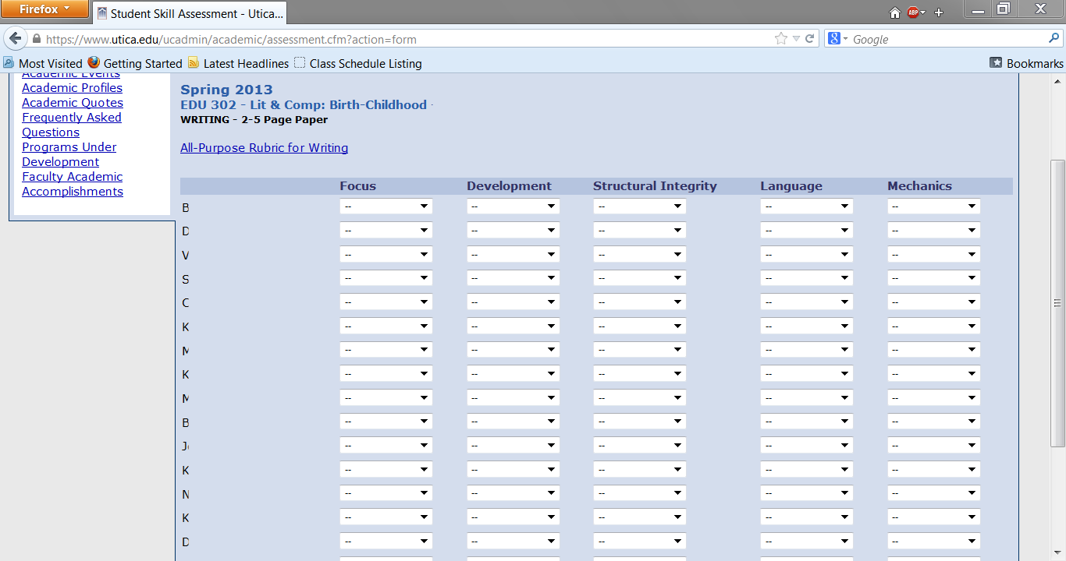
Your class roster will be provided. The names for this course have been concealed, however the letters on the left indicate where you will see the names of your students.
Notes:
Donut with text inside
(Intermediate)
To reproduce the circle effects on this slide, do the following:
On the Home tab, in the Slides group, click Layout, and then click Blank.
On the Home tab, in the Drawing group, click Shapes, and then under Basic Shapes click Donut (third row, second option from the left). On the slide, drag to draw a donut.
Drag the yellow diamond adjustment handle to the left to decrease the width of the donut.
Select the donut. Under Drawing Tools, on the Format tab, in the Size group, do the following:
In the Shape Height box, enter 5.92”.
In the Shape Width box, enter 5.92”.
Under Drawing Tools, on the Format tab, in the Shape Styles group, click the arrow next to Shape Outline, and then click No Outline.
Also under Drawing Tools, on the Format tab, in the Shape Styles group, click the arrow next to Shape Fill, and then under Theme Colors click Olive Green, Accent 3, Darker 25% (fifth row, seventh option from the left).
Also under Drawing Tools, on the Format tab, in the Shape Styles group, click Shape Effects, and then do the following:
Point to Bevel, and then under Bevel click Soft Round (second row, second option from the left).
Point to Shadow, and then under Outer click Offset Diagonal Bottom Right (first row, first option from the left).
To reproduce the text on this slide, do the following:
On the Insert tab, in the Text group, click Text Box, and then on the slide, drag to draw the text box.
Enter text in the text box, select the text, and then on the Home tab, in the Font group, select Consolas from the Font list, enter 27 in the Font Size box, click the button next to Font Color, and then under Theme Colors click White, Background 1 (first row, first option from the left). Tip: To enter the two bullets with the text, on the Insert tab, in the Text group, click Symbol. In the Symbol dialog box, do the following:
In the Font list, select (normal text).
In the Character Code box, enter 0095 to select BULLET, and then click Insert.
On the Home tab, in the Paragraph group, click Align Text Left to align the text left in the text box.
Select the text box. Under Drawing Tools, on the Format tab, in the WordArt Styles group, click Text Effects, and then do the following:
Point to Shadow, and then under Outer click Offset Diagonal Bottom Right (first row, first option from the left).
Point to Transform, and then under Follow Path click Circle (third option from the left).
Under Drawing Tools, on the Format tab, in the Size group, do the following:
In the Shape Height box, enter 4.78”.
In the Shape Width box, enter 4.78”.
Drag the text box onto the donut shape so that the text wraps around the donut.
If the text does not wrap completely and evenly around the donut shape, select the text box and then do the following:
If the text does not wrap completely around the donut shape, on the Home tab, in the Font group, in the Font Size box, enter larger font sizes in 1-pt increments until the text is evenly spaced within the donut shape.
If the entire line of text does not fit evenly within the donut shape, on the Home tab, in the Font group, in the Font Size box, enter smaller font sizes in 1-pt increments until the text is evenly spaced within the donut shape.
If the text does not wrap completely around or does not fit evenly within the donut shape, also try editing the Character Spacing. On the Home tab, in the Font group, click Character Spacing, and then do the following:
To expand the text, in the Character Spacing list, select Loose or Very Loose.
To contract the text, in the Character Spacing list, select Tight or Very Tight.
For more precise character spacing, click More Spacing. In the Font dialog box, on the Character Spacing tab, in the Spacing list, select Expanded or Condensed. In the By box, adjust the size by 0.1-pt increments until the text is spaced evenly.
Press and hold SHIFT and select the text box and the donut shape. On the Home tab, in the Drawing group, click Arrange, and then click Group.
Select the group. On the Home tab, in the Drawing group, click Arrange, point to Align, and then do the following:
Click Align to Slide.
Click Align Center.
Click Align Middle.
To reproduce the background on this slide, do the following:
Right-click the slide background area, and then click Format Background. In the Format Background dialog box, click Fill in the left pane, select Gradient fill in the Fill pane, and then do the following:
In the Type list, select Radial.
Click the button next to Direction, and then click From Center (third option from the left).
Under Gradient stops, click Add gradient stop or Remove gradient stop until three stops appear in the slider.
Also under Gradient stops, customize the gradient stops that you added as follows:
Select the first stop in the slider, and then do the following:
In the Position box, enter 0%.
Click the button next to Color, and then under Theme Colors click Aqua, Accent 5, Darker 25% (fifth row, ninth option from the left).
Select the next stop in the slider, and then do the following:
In the Position box, enter 54%.
Click the button next to Color, and then under Theme Colors click Aqua, Accent 5, Darker 50% (sixth row, ninth option from the left).
Select the last stop in the slider, and then do the following:
In the Position box, enter 100%.
Click the button next to Color, and then under Theme Colors click Black, Text 1 (first row, second option from the left).

Slide 10
The elements of the General Education rubric have been listed across the top of the table. These will vary depending on the General Education rubric.
Notes:
Donut with text inside
(Intermediate)
To reproduce the circle effects on this slide, do the following:
On the Home tab, in the Slides group, click Layout, and then click Blank.
On the Home tab, in the Drawing group, click Shapes, and then under Basic Shapes click Donut (third row, second option from the left). On the slide, drag to draw a donut.
Drag the yellow diamond adjustment handle to the left to decrease the width of the donut.
Select the donut. Under Drawing Tools, on the Format tab, in the Size group, do the following:
In the Shape Height box, enter 5.92”.
In the Shape Width box, enter 5.92”.
Under Drawing Tools, on the Format tab, in the Shape Styles group, click the arrow next to Shape Outline, and then click No Outline.
Also under Drawing Tools, on the Format tab, in the Shape Styles group, click the arrow next to Shape Fill, and then under Theme Colors click Olive Green, Accent 3, Darker 25% (fifth row, seventh option from the left).
Also under Drawing Tools, on the Format tab, in the Shape Styles group, click Shape Effects, and then do the following:
Point to Bevel, and then under Bevel click Soft Round (second row, second option from the left).
Point to Shadow, and then under Outer click Offset Diagonal Bottom Right (first row, first option from the left).
To reproduce the text on this slide, do the following:
On the Insert tab, in the Text group, click Text Box, and then on the slide, drag to draw the text box.
Enter text in the text box, select the text, and then on the Home tab, in the Font group, select Consolas from the Font list, enter 27 in the Font Size box, click the button next to Font Color, and then under Theme Colors click White, Background 1 (first row, first option from the left). Tip: To enter the two bullets with the text, on the Insert tab, in the Text group, click Symbol. In the Symbol dialog box, do the following:
In the Font list, select (normal text).
In the Character Code box, enter 0095 to select BULLET, and then click Insert.
On the Home tab, in the Paragraph group, click Align Text Left to align the text left in the text box.
Select the text box. Under Drawing Tools, on the Format tab, in the WordArt Styles group, click Text Effects, and then do the following:
Point to Shadow, and then under Outer click Offset Diagonal Bottom Right (first row, first option from the left).
Point to Transform, and then under Follow Path click Circle (third option from the left).
Under Drawing Tools, on the Format tab, in the Size group, do the following:
In the Shape Height box, enter 4.78”.
In the Shape Width box, enter 4.78”.
Drag the text box onto the donut shape so that the text wraps around the donut.
If the text does not wrap completely and evenly around the donut shape, select the text box and then do the following:
If the text does not wrap completely around the donut shape, on the Home tab, in the Font group, in the Font Size box, enter larger font sizes in 1-pt increments until the text is evenly spaced within the donut shape.
If the entire line of text does not fit evenly within the donut shape, on the Home tab, in the Font group, in the Font Size box, enter smaller font sizes in 1-pt increments until the text is evenly spaced within the donut shape.
If the text does not wrap completely around or does not fit evenly within the donut shape, also try editing the Character Spacing. On the Home tab, in the Font group, click Character Spacing, and then do the following:
To expand the text, in the Character Spacing list, select Loose or Very Loose.
To contract the text, in the Character Spacing list, select Tight or Very Tight.
For more precise character spacing, click More Spacing. In the Font dialog box, on the Character Spacing tab, in the Spacing list, select Expanded or Condensed. In the By box, adjust the size by 0.1-pt increments until the text is spaced evenly.
Press and hold SHIFT and select the text box and the donut shape. On the Home tab, in the Drawing group, click Arrange, and then click Group.
Select the group. On the Home tab, in the Drawing group, click Arrange, point to Align, and then do the following:
Click Align to Slide.
Click Align Center.
Click Align Middle.
To reproduce the background on this slide, do the following:
Right-click the slide background area, and then click Format Background. In the Format Background dialog box, click Fill in the left pane, select Gradient fill in the Fill pane, and then do the following:
In the Type list, select Radial.
Click the button next to Direction, and then click From Center (third option from the left).
Under Gradient stops, click Add gradient stop or Remove gradient stop until three stops appear in the slider.
Also under Gradient stops, customize the gradient stops that you added as follows:
Select the first stop in the slider, and then do the following:
In the Position box, enter 0%.
Click the button next to Color, and then under Theme Colors click Aqua, Accent 5, Darker 25% (fifth row, ninth option from the left).
Select the next stop in the slider, and then do the following:
In the Position box, enter 54%.
Click the button next to Color, and then under Theme Colors click Aqua, Accent 5, Darker 50% (sixth row, ninth option from the left).
Select the last stop in the slider, and then do the following:
In the Position box, enter 100%.
Click the button next to Color, and then under Theme Colors click Black, Text 1 (first row, second option from the left).

Slide 11
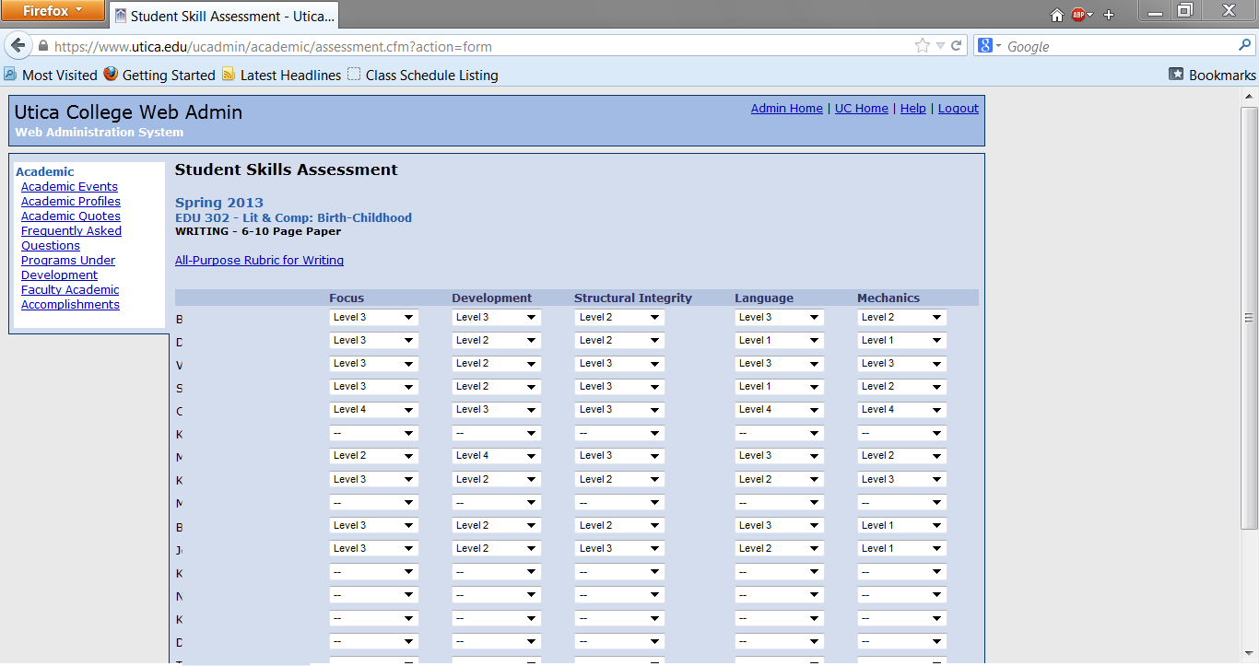
Here the faculty member has entered the data for the students of the course. The correct rubric level for each student has been identified. If a student did not complete the assignment, please leave the box empty.
Notes:
Donut with text inside
(Intermediate)
To reproduce the circle effects on this slide, do the following:
On the Home tab, in the Slides group, click Layout, and then click Blank.
On the Home tab, in the Drawing group, click Shapes, and then under Basic Shapes click Donut (third row, second option from the left). On the slide, drag to draw a donut.
Drag the yellow diamond adjustment handle to the left to decrease the width of the donut.
Select the donut. Under Drawing Tools, on the Format tab, in the Size group, do the following:
In the Shape Height box, enter 5.92”.
In the Shape Width box, enter 5.92”.
Under Drawing Tools, on the Format tab, in the Shape Styles group, click the arrow next to Shape Outline, and then click No Outline.
Also under Drawing Tools, on the Format tab, in the Shape Styles group, click the arrow next to Shape Fill, and then under Theme Colors click Olive Green, Accent 3, Darker 25% (fifth row, seventh option from the left).
Also under Drawing Tools, on the Format tab, in the Shape Styles group, click Shape Effects, and then do the following:
Point to Bevel, and then under Bevel click Soft Round (second row, second option from the left).
Point to Shadow, and then under Outer click Offset Diagonal Bottom Right (first row, first option from the left).
To reproduce the text on this slide, do the following:
On the Insert tab, in the Text group, click Text Box, and then on the slide, drag to draw the text box.
Enter text in the text box, select the text, and then on the Home tab, in the Font group, select Consolas from the Font list, enter 27 in the Font Size box, click the button next to Font Color, and then under Theme Colors click White, Background 1 (first row, first option from the left). Tip: To enter the two bullets with the text, on the Insert tab, in the Text group, click Symbol. In the Symbol dialog box, do the following:
In the Font list, select (normal text).
In the Character Code box, enter 0095 to select BULLET, and then click Insert.
On the Home tab, in the Paragraph group, click Align Text Left to align the text left in the text box.
Select the text box. Under Drawing Tools, on the Format tab, in the WordArt Styles group, click Text Effects, and then do the following:
Point to Shadow, and then under Outer click Offset Diagonal Bottom Right (first row, first option from the left).
Point to Transform, and then under Follow Path click Circle (third option from the left).
Under Drawing Tools, on the Format tab, in the Size group, do the following:
In the Shape Height box, enter 4.78”.
In the Shape Width box, enter 4.78”.
Drag the text box onto the donut shape so that the text wraps around the donut.
If the text does not wrap completely and evenly around the donut shape, select the text box and then do the following:
If the text does not wrap completely around the donut shape, on the Home tab, in the Font group, in the Font Size box, enter larger font sizes in 1-pt increments until the text is evenly spaced within the donut shape.
If the entire line of text does not fit evenly within the donut shape, on the Home tab, in the Font group, in the Font Size box, enter smaller font sizes in 1-pt increments until the text is evenly spaced within the donut shape.
If the text does not wrap completely around or does not fit evenly within the donut shape, also try editing the Character Spacing. On the Home tab, in the Font group, click Character Spacing, and then do the following:
To expand the text, in the Character Spacing list, select Loose or Very Loose.
To contract the text, in the Character Spacing list, select Tight or Very Tight.
For more precise character spacing, click More Spacing. In the Font dialog box, on the Character Spacing tab, in the Spacing list, select Expanded or Condensed. In the By box, adjust the size by 0.1-pt increments until the text is spaced evenly.
Press and hold SHIFT and select the text box and the donut shape. On the Home tab, in the Drawing group, click Arrange, and then click Group.
Select the group. On the Home tab, in the Drawing group, click Arrange, point to Align, and then do the following:
Click Align to Slide.
Click Align Center.
Click Align Middle.
To reproduce the background on this slide, do the following:
Right-click the slide background area, and then click Format Background. In the Format Background dialog box, click Fill in the left pane, select Gradient fill in the Fill pane, and then do the following:
In the Type list, select Radial.
Click the button next to Direction, and then click From Center (third option from the left).
Under Gradient stops, click Add gradient stop or Remove gradient stop until three stops appear in the slider.
Also under Gradient stops, customize the gradient stops that you added as follows:
Select the first stop in the slider, and then do the following:
In the Position box, enter 0%.
Click the button next to Color, and then under Theme Colors click Aqua, Accent 5, Darker 25% (fifth row, ninth option from the left).
Select the next stop in the slider, and then do the following:
In the Position box, enter 54%.
Click the button next to Color, and then under Theme Colors click Aqua, Accent 5, Darker 50% (sixth row, ninth option from the left).
Select the last stop in the slider, and then do the following:
In the Position box, enter 100%.
Click the button next to Color, and then under Theme Colors click Black, Text 1 (first row, second option from the left).

Slide 12
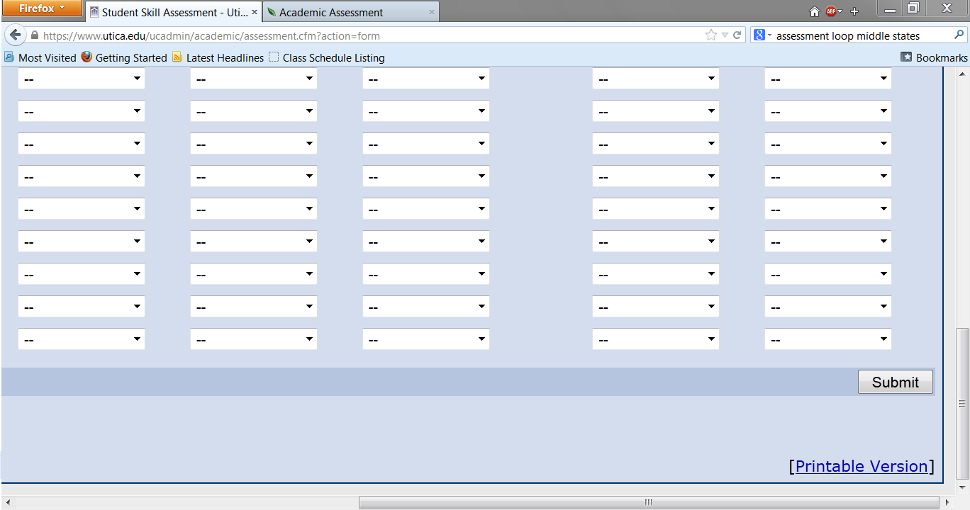
After the table has been completed, hit the Submit button on the bottom right.
Notes:
Donut with text inside
(Intermediate)
To reproduce the circle effects on this slide, do the following:
On the Home tab, in the Slides group, click Layout, and then click Blank.
On the Home tab, in the Drawing group, click Shapes, and then under Basic Shapes click Donut (third row, second option from the left). On the slide, drag to draw a donut.
Drag the yellow diamond adjustment handle to the left to decrease the width of the donut.
Select the donut. Under Drawing Tools, on the Format tab, in the Size group, do the following:
In the Shape Height box, enter 5.92”.
In the Shape Width box, enter 5.92”.
Under Drawing Tools, on the Format tab, in the Shape Styles group, click the arrow next to Shape Outline, and then click No Outline.
Also under Drawing Tools, on the Format tab, in the Shape Styles group, click the arrow next to Shape Fill, and then under Theme Colors click Olive Green, Accent 3, Darker 25% (fifth row, seventh option from the left).
Also under Drawing Tools, on the Format tab, in the Shape Styles group, click Shape Effects, and then do the following:
Point to Bevel, and then under Bevel click Soft Round (second row, second option from the left).
Point to Shadow, and then under Outer click Offset Diagonal Bottom Right (first row, first option from the left).
To reproduce the text on this slide, do the following:
On the Insert tab, in the Text group, click Text Box, and then on the slide, drag to draw the text box.
Enter text in the text box, select the text, and then on the Home tab, in the Font group, select Consolas from the Font list, enter 27 in the Font Size box, click the button next to Font Color, and then under Theme Colors click White, Background 1 (first row, first option from the left). Tip: To enter the two bullets with the text, on the Insert tab, in the Text group, click Symbol. In the Symbol dialog box, do the following:
In the Font list, select (normal text).
In the Character Code box, enter 0095 to select BULLET, and then click Insert.
On the Home tab, in the Paragraph group, click Align Text Left to align the text left in the text box.
Select the text box. Under Drawing Tools, on the Format tab, in the WordArt Styles group, click Text Effects, and then do the following:
Point to Shadow, and then under Outer click Offset Diagonal Bottom Right (first row, first option from the left).
Point to Transform, and then under Follow Path click Circle (third option from the left).
Under Drawing Tools, on the Format tab, in the Size group, do the following:
In the Shape Height box, enter 4.78”.
In the Shape Width box, enter 4.78”.
Drag the text box onto the donut shape so that the text wraps around the donut.
If the text does not wrap completely and evenly around the donut shape, select the text box and then do the following:
If the text does not wrap completely around the donut shape, on the Home tab, in the Font group, in the Font Size box, enter larger font sizes in 1-pt increments until the text is evenly spaced within the donut shape.
If the entire line of text does not fit evenly within the donut shape, on the Home tab, in the Font group, in the Font Size box, enter smaller font sizes in 1-pt increments until the text is evenly spaced within the donut shape.
If the text does not wrap completely around or does not fit evenly within the donut shape, also try editing the Character Spacing. On the Home tab, in the Font group, click Character Spacing, and then do the following:
To expand the text, in the Character Spacing list, select Loose or Very Loose.
To contract the text, in the Character Spacing list, select Tight or Very Tight.
For more precise character spacing, click More Spacing. In the Font dialog box, on the Character Spacing tab, in the Spacing list, select Expanded or Condensed. In the By box, adjust the size by 0.1-pt increments until the text is spaced evenly.
Press and hold SHIFT and select the text box and the donut shape. On the Home tab, in the Drawing group, click Arrange, and then click Group.
Select the group. On the Home tab, in the Drawing group, click Arrange, point to Align, and then do the following:
Click Align to Slide.
Click Align Center.
Click Align Middle.
To reproduce the background on this slide, do the following:
Right-click the slide background area, and then click Format Background. In the Format Background dialog box, click Fill in the left pane, select Gradient fill in the Fill pane, and then do the following:
In the Type list, select Radial.
Click the button next to Direction, and then click From Center (third option from the left).
Under Gradient stops, click Add gradient stop or Remove gradient stop until three stops appear in the slider.
Also under Gradient stops, customize the gradient stops that you added as follows:
Select the first stop in the slider, and then do the following:
In the Position box, enter 0%.
Click the button next to Color, and then under Theme Colors click Aqua, Accent 5, Darker 25% (fifth row, ninth option from the left).
Select the next stop in the slider, and then do the following:
In the Position box, enter 54%.
Click the button next to Color, and then under Theme Colors click Aqua, Accent 5, Darker 50% (sixth row, ninth option from the left).
Select the last stop in the slider, and then do the following:
In the Position box, enter 100%.
Click the button next to Color, and then under Theme Colors click Black, Text 1 (first row, second option from the left).

Slide 13
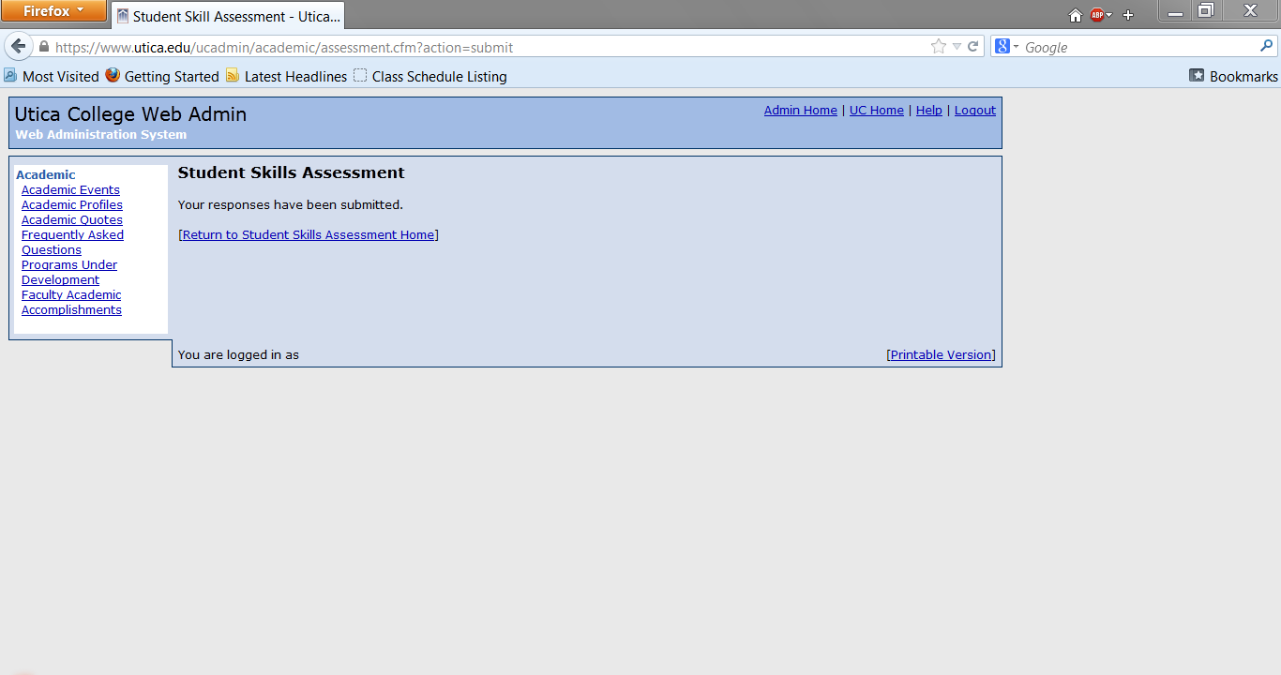
This is the page you will see after submission of the data for one course. If you have data to submit for another course you can click the return link in the middle of the page. If you have completed your data entry, the logout link is located in the top right corner.
Notes:
Donut with text inside
(Intermediate)
To reproduce the circle effects on this slide, do the following:
On the Home tab, in the Slides group, click Layout, and then click Blank.
On the Home tab, in the Drawing group, click Shapes, and then under Basic Shapes click Donut (third row, second option from the left). On the slide, drag to draw a donut.
Drag the yellow diamond adjustment handle to the left to decrease the width of the donut.
Select the donut. Under Drawing Tools, on the Format tab, in the Size group, do the following:
In the Shape Height box, enter 5.92”.
In the Shape Width box, enter 5.92”.
Under Drawing Tools, on the Format tab, in the Shape Styles group, click the arrow next to Shape Outline, and then click No Outline.
Also under Drawing Tools, on the Format tab, in the Shape Styles group, click the arrow next to Shape Fill, and then under Theme Colors click Olive Green, Accent 3, Darker 25% (fifth row, seventh option from the left).
Also under Drawing Tools, on the Format tab, in the Shape Styles group, click Shape Effects, and then do the following:
Point to Bevel, and then under Bevel click Soft Round (second row, second option from the left).
Point to Shadow, and then under Outer click Offset Diagonal Bottom Right (first row, first option from the left).
To reproduce the text on this slide, do the following:
On the Insert tab, in the Text group, click Text Box, and then on the slide, drag to draw the text box.
Enter text in the text box, select the text, and then on the Home tab, in the Font group, select Consolas from the Font list, enter 27 in the Font Size box, click the button next to Font Color, and then under Theme Colors click White, Background 1 (first row, first option from the left). Tip: To enter the two bullets with the text, on the Insert tab, in the Text group, click Symbol. In the Symbol dialog box, do the following:
In the Font list, select (normal text).
In the Character Code box, enter 0095 to select BULLET, and then click Insert.
On the Home tab, in the Paragraph group, click Align Text Left to align the text left in the text box.
Select the text box. Under Drawing Tools, on the Format tab, in the WordArt Styles group, click Text Effects, and then do the following:
Point to Shadow, and then under Outer click Offset Diagonal Bottom Right (first row, first option from the left).
Point to Transform, and then under Follow Path click Circle (third option from the left).
Under Drawing Tools, on the Format tab, in the Size group, do the following:
In the Shape Height box, enter 4.78”.
In the Shape Width box, enter 4.78”.
Drag the text box onto the donut shape so that the text wraps around the donut.
If the text does not wrap completely and evenly around the donut shape, select the text box and then do the following:
If the text does not wrap completely around the donut shape, on the Home tab, in the Font group, in the Font Size box, enter larger font sizes in 1-pt increments until the text is evenly spaced within the donut shape.
If the entire line of text does not fit evenly within the donut shape, on the Home tab, in the Font group, in the Font Size box, enter smaller font sizes in 1-pt increments until the text is evenly spaced within the donut shape.
If the text does not wrap completely around or does not fit evenly within the donut shape, also try editing the Character Spacing. On the Home tab, in the Font group, click Character Spacing, and then do the following:
To expand the text, in the Character Spacing list, select Loose or Very Loose.
To contract the text, in the Character Spacing list, select Tight or Very Tight.
For more precise character spacing, click More Spacing. In the Font dialog box, on the Character Spacing tab, in the Spacing list, select Expanded or Condensed. In the By box, adjust the size by 0.1-pt increments until the text is spaced evenly.
Press and hold SHIFT and select the text box and the donut shape. On the Home tab, in the Drawing group, click Arrange, and then click Group.
Select the group. On the Home tab, in the Drawing group, click Arrange, point to Align, and then do the following:
Click Align to Slide.
Click Align Center.
Click Align Middle.
To reproduce the background on this slide, do the following:
Right-click the slide background area, and then click Format Background. In the Format Background dialog box, click Fill in the left pane, select Gradient fill in the Fill pane, and then do the following:
In the Type list, select Radial.
Click the button next to Direction, and then click From Center (third option from the left).
Under Gradient stops, click Add gradient stop or Remove gradient stop until three stops appear in the slider.
Also under Gradient stops, customize the gradient stops that you added as follows:
Select the first stop in the slider, and then do the following:
In the Position box, enter 0%.
Click the button next to Color, and then under Theme Colors click Aqua, Accent 5, Darker 25% (fifth row, ninth option from the left).
Select the next stop in the slider, and then do the following:
In the Position box, enter 54%.
Click the button next to Color, and then under Theme Colors click Aqua, Accent 5, Darker 50% (sixth row, ninth option from the left).
Select the last stop in the slider, and then do the following:
In the Position box, enter 100%.
Click the button next to Color, and then under Theme Colors click Black, Text 1 (first row, second option from the left).

Slide 14
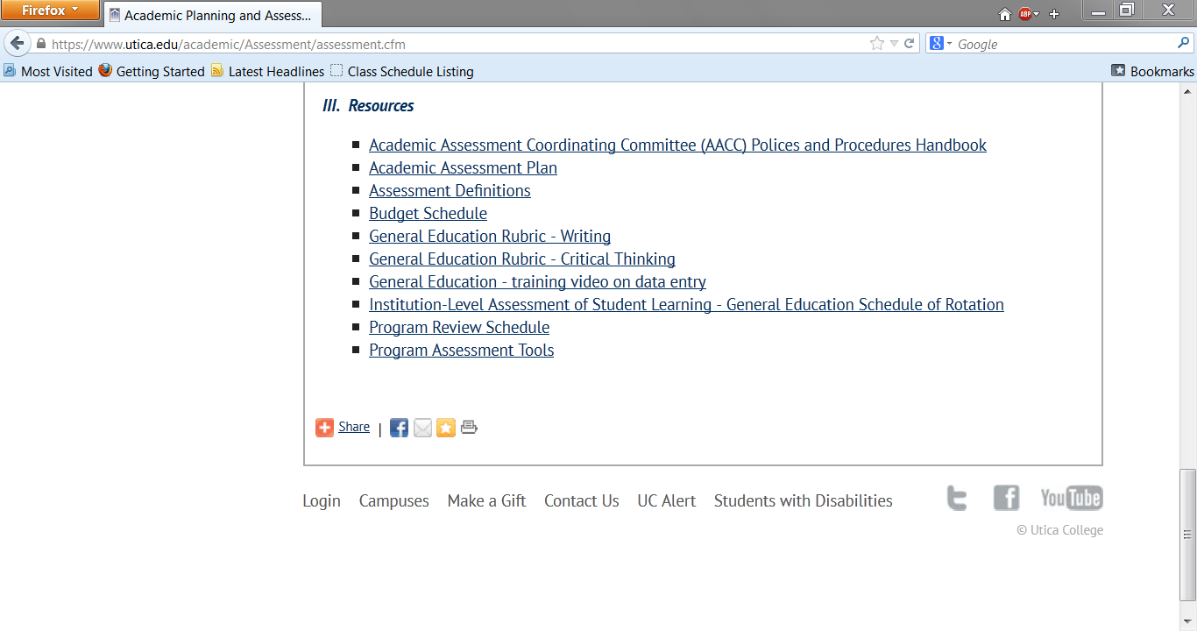
The General Education rubrics are located on the Academic Assessment web page under the Resources section at the bottom of the page.
The link for the Academic Assessment web page: https://www.utica.edu/academic/Assessment/assessment.cfm
Notes:
Donut with text inside
(Intermediate)
To reproduce the circle effects on this slide, do the following:
On the Home tab, in the Slides group, click Layout, and then click Blank.
On the Home tab, in the Drawing group, click Shapes, and then under Basic Shapes click Donut (third row, second option from the left). On the slide, drag to draw a donut.
Drag the yellow diamond adjustment handle to the left to decrease the width of the donut.
Select the donut. Under Drawing Tools, on the Format tab, in the Size group, do the following:
In the Shape Height box, enter 5.92”.
In the Shape Width box, enter 5.92”.
Under Drawing Tools, on the Format tab, in the Shape Styles group, click the arrow next to Shape Outline, and then click No Outline.
Also under Drawing Tools, on the Format tab, in the Shape Styles group, click the arrow next to Shape Fill, and then under Theme Colors click Olive Green, Accent 3, Darker 25% (fifth row, seventh option from the left).
Also under Drawing Tools, on the Format tab, in the Shape Styles group, click Shape Effects, and then do the following:
Point to Bevel, and then under Bevel click Soft Round (second row, second option from the left).
Point to Shadow, and then under Outer click Offset Diagonal Bottom Right (first row, first option from the left).
To reproduce the text on this slide, do the following:
On the Insert tab, in the Text group, click Text Box, and then on the slide, drag to draw the text box.
Enter text in the text box, select the text, and then on the Home tab, in the Font group, select Consolas from the Font list, enter 27 in the Font Size box, click the button next to Font Color, and then under Theme Colors click White, Background 1 (first row, first option from the left). Tip: To enter the two bullets with the text, on the Insert tab, in the Text group, click Symbol. In the Symbol dialog box, do the following:
In the Font list, select (normal text).
In the Character Code box, enter 0095 to select BULLET, and then click Insert.
On the Home tab, in the Paragraph group, click Align Text Left to align the text left in the text box.
Select the text box. Under Drawing Tools, on the Format tab, in the WordArt Styles group, click Text Effects, and then do the following:
Point to Shadow, and then under Outer click Offset Diagonal Bottom Right (first row, first option from the left).
Point to Transform, and then under Follow Path click Circle (third option from the left).
Under Drawing Tools, on the Format tab, in the Size group, do the following:
In the Shape Height box, enter 4.78”.
In the Shape Width box, enter 4.78”.
Drag the text box onto the donut shape so that the text wraps around the donut.
If the text does not wrap completely and evenly around the donut shape, select the text box and then do the following:
If the text does not wrap completely around the donut shape, on the Home tab, in the Font group, in the Font Size box, enter larger font sizes in 1-pt increments until the text is evenly spaced within the donut shape.
If the entire line of text does not fit evenly within the donut shape, on the Home tab, in the Font group, in the Font Size box, enter smaller font sizes in 1-pt increments until the text is evenly spaced within the donut shape.
If the text does not wrap completely around or does not fit evenly within the donut shape, also try editing the Character Spacing. On the Home tab, in the Font group, click Character Spacing, and then do the following:
To expand the text, in the Character Spacing list, select Loose or Very Loose.
To contract the text, in the Character Spacing list, select Tight or Very Tight.
For more precise character spacing, click More Spacing. In the Font dialog box, on the Character Spacing tab, in the Spacing list, select Expanded or Condensed. In the By box, adjust the size by 0.1-pt increments until the text is spaced evenly.
Press and hold SHIFT and select the text box and the donut shape. On the Home tab, in the Drawing group, click Arrange, and then click Group.
Select the group. On the Home tab, in the Drawing group, click Arrange, point to Align, and then do the following:
Click Align to Slide.
Click Align Center.
Click Align Middle.
To reproduce the background on this slide, do the following:
Right-click the slide background area, and then click Format Background. In the Format Background dialog box, click Fill in the left pane, select Gradient fill in the Fill pane, and then do the following:
In the Type list, select Radial.
Click the button next to Direction, and then click From Center (third option from the left).
Under Gradient stops, click Add gradient stop or Remove gradient stop until three stops appear in the slider.
Also under Gradient stops, customize the gradient stops that you added as follows:
Select the first stop in the slider, and then do the following:
In the Position box, enter 0%.
Click the button next to Color, and then under Theme Colors click Aqua, Accent 5, Darker 25% (fifth row, ninth option from the left).
Select the next stop in the slider, and then do the following:
In the Position box, enter 54%.
Click the button next to Color, and then under Theme Colors click Aqua, Accent 5, Darker 50% (sixth row, ninth option from the left).
Select the last stop in the slider, and then do the following:
In the Position box, enter 100%.
Click the button next to Color, and then under Theme Colors click Black, Text 1 (first row, second option from the left).

Slide 15
ASSESSMENT OF INSTITUTION-LEVEL STUDENT LEARNING GOALS • UTICA COLLEGE •
Thank you for taking part in
Utica College’s Institution-Level Assessment of Student Learning.
Your time and attention is valued.
Questions?
Email: Jackie Snyder,
Director of Academic Assessment
jesnyder@utica.edu
Notes:
Donut with text inside
(Intermediate)
To reproduce the circle effects on this slide, do the following:
On the Home tab, in the Slides group, click Layout, and then click Blank.
On the Home tab, in the Drawing group, click Shapes, and then under Basic Shapes click Donut (third row, second option from the left). On the slide, drag to draw a donut.
Drag the yellow diamond adjustment handle to the left to decrease the width of the donut.
Select the donut. Under Drawing Tools, on the Format tab, in the Size group, do the following:
In the Shape Height box, enter 5.92”.
In the Shape Width box, enter 5.92”.
Under Drawing Tools, on the Format tab, in the Shape Styles group, click the arrow next to Shape Outline, and then click No Outline.
Also under Drawing Tools, on the Format tab, in the Shape Styles group, click the arrow next to Shape Fill, and then under Theme Colors click Olive Green, Accent 3, Darker 25% (fifth row, seventh option from the left).
Also under Drawing Tools, on the Format tab, in the Shape Styles group, click Shape Effects, and then do the following:
Point to Bevel, and then under Bevel click Soft Round (second row, second option from the left).
Point to Shadow, and then under Outer click Offset Diagonal Bottom Right (first row, first option from the left).
To reproduce the text on this slide, do the following:
On the Insert tab, in the Text group, click Text Box, and then on the slide, drag to draw the text box.
Enter text in the text box, select the text, and then on the Home tab, in the Font group, select Consolas from the Font list, enter 27 in the Font Size box, click the button next to Font Color, and then under Theme Colors click White, Background 1 (first row, first option from the left). Tip: To enter the two bullets with the text, on the Insert tab, in the Text group, click Symbol. In the Symbol dialog box, do the following:
In the Font list, select (normal text).
In the Character Code box, enter 0095 to select BULLET, and then click Insert.
On the Home tab, in the Paragraph group, click Align Text Left to align the text left in the text box.
Select the text box. Under Drawing Tools, on the Format tab, in the WordArt Styles group, click Text Effects, and then do the following:
Point to Shadow, and then under Outer click Offset Diagonal Bottom Right (first row, first option from the left).
Point to Transform, and then under Follow Path click Circle (third option from the left).
Under Drawing Tools, on the Format tab, in the Size group, do the following:
In the Shape Height box, enter 4.78”.
In the Shape Width box, enter 4.78”.
Drag the text box onto the donut shape so that the text wraps around the donut.
If the text does not wrap completely and evenly around the donut shape, select the text box and then do the following:
If the text does not wrap completely around the donut shape, on the Home tab, in the Font group, in the Font Size box, enter larger font sizes in 1-pt increments until the text is evenly spaced within the donut shape.
If the entire line of text does not fit evenly within the donut shape, on the Home tab, in the Font group, in the Font Size box, enter smaller font sizes in 1-pt increments until the text is evenly spaced within the donut shape.
If the text does not wrap completely around or does not fit evenly within the donut shape, also try editing the Character Spacing. On the Home tab, in the Font group, click Character Spacing, and then do the following:
To expand the text, in the Character Spacing list, select Loose or Very Loose.
To contract the text, in the Character Spacing list, select Tight or Very Tight.
For more precise character spacing, click More Spacing. In the Font dialog box, on the Character Spacing tab, in the Spacing list, select Expanded or Condensed. In the By box, adjust the size by 0.1-pt increments until the text is spaced evenly.
Press and hold SHIFT and select the text box and the donut shape. On the Home tab, in the Drawing group, click Arrange, and then click Group.
Select the group. On the Home tab, in the Drawing group, click Arrange, point to Align, and then do the following:
Click Align to Slide.
Click Align Center.
Click Align Middle.
To reproduce the background on this slide, do the following:
Right-click the slide background area, and then click Format Background. In the Format Background dialog box, click Fill in the left pane, select Gradient fill in the Fill pane, and then do the following:
In the Type list, select Radial.
Click the button next to Direction, and then click From Center (third option from the left).
Under Gradient stops, click Add gradient stop or Remove gradient stop until three stops appear in the slider.
Also under Gradient stops, customize the gradient stops that you added as follows:
Select the first stop in the slider, and then do the following:
In the Position box, enter 0%.
Click the button next to Color, and then under Theme Colors click Aqua, Accent 5, Darker 25% (fifth row, ninth option from the left).
Select the next stop in the slider, and then do the following:
In the Position box, enter 54%.
Click the button next to Color, and then under Theme Colors click Aqua, Accent 5, Darker 50% (sixth row, ninth option from the left).
Select the last stop in the slider, and then do the following:
In the Position box, enter 100%.
Click the button next to Color, and then under Theme Colors click Black, Text 1 (first row, second option from the left).

