Slide 1
Internet
Investigations

Slide 2
Internet Investigations
“There’s a charge on my credit card, but I didn’t make that purchase.”
Most common criminal investigation
“I paid for it, but I didn’t receive it.”
eBay
“Someone hacked my….”
Bank account
E-mail account

Slide 3
Internet Investigations
Key elements to a successful investigation
Location of the offender
Where in the world are they
Identification of the offender
Who was typing on the keyboard
Admission by the offender
Prosecutors like confessions

Slide 4
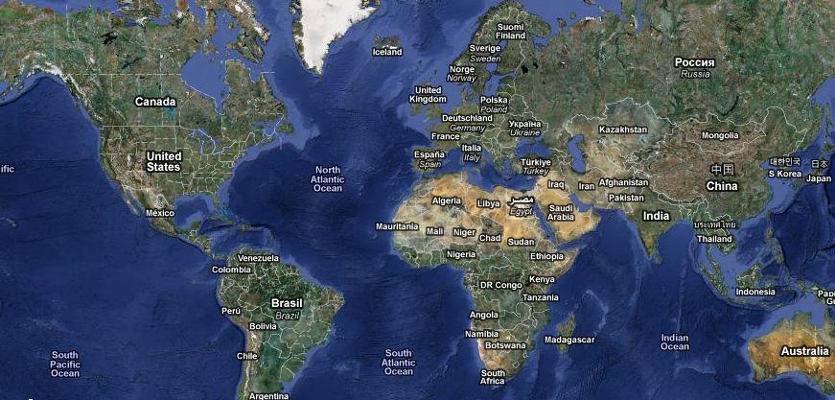
Internet Investigations
Location
Where in the world are they….Literally

Slide 5
Internet Investigations
Location
Begin with the company where the unauthorized activity occurred

Slide 6
Internet Investigations

Slide 7
Internet Investigations
Location
Begin with the company where the unauthorized activity occurred
Was an I.P. Address captured
Confirm time zone of I.P. Address capture

Slide 8
Internet INvestigations

Slide 9
Internet Investigations
Location
The company where the unauthorized activity occurred
Was an I.P. Address captured
Confirm time zone of I.P. Address capture
Internet Service Provider
Search Warrant for subscriber records
May need to account for time zone differences

Slide 10
Internet Investigations
Key Elements of a Successful Investigation
Location of the offender
Identification of the offender

Slide 11
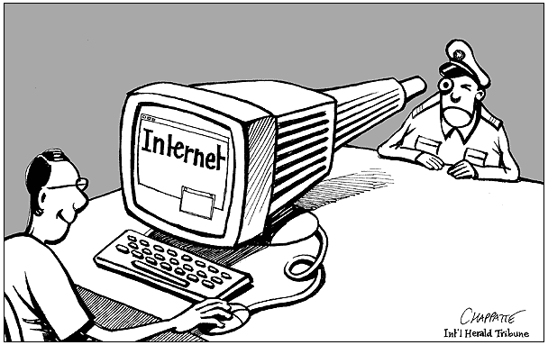
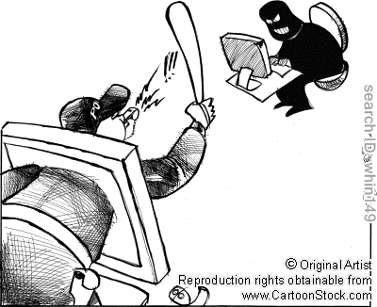
Internet Investigations
Identification

Slide 12
Internet investigations
Identification
Though probably false, gather all information provided to company at the time of the transaction
Verify a connection between the offender and the location provided by the I.S.P.
Additional search warrant(s) might be necessary to gather additional information and or to seize the offender’s computer

Slide 13
Internet Investigations
Key Elements of a Successful Investigation
Location of the offender
Identification of the offender
Admission by the offender

Slide 14
Internet investigations
Admission
In general, without a confession prosecutors are less likely to file charges
Be prepared for the interview
Don’t rush an interview
Interviewing is a skill that needs to be practiced

Slide 15
Internet investigations
Paul Pantani
Senior Investigator – Consumer Fraud Unit
Riverside County District Attorneys Office
951-955-0822
paulpantani@rivcoda.org

